Slide 1
How does it work?
Lecture 1 – General overview of the Equatorial region
Lecture 2 – Ocean Currents
Lecture 3 – Upwelling at the Equator
Lecture 4 – El Nino/La Nina
Lecture 5 – Monsoon
Lecture 6 – Coastal Upwelling
Lecture 7 – Impact of variability on a coastal upwelling system – case study Benguela
Lecture 8 – Open Ocean upwelling

Slide 2
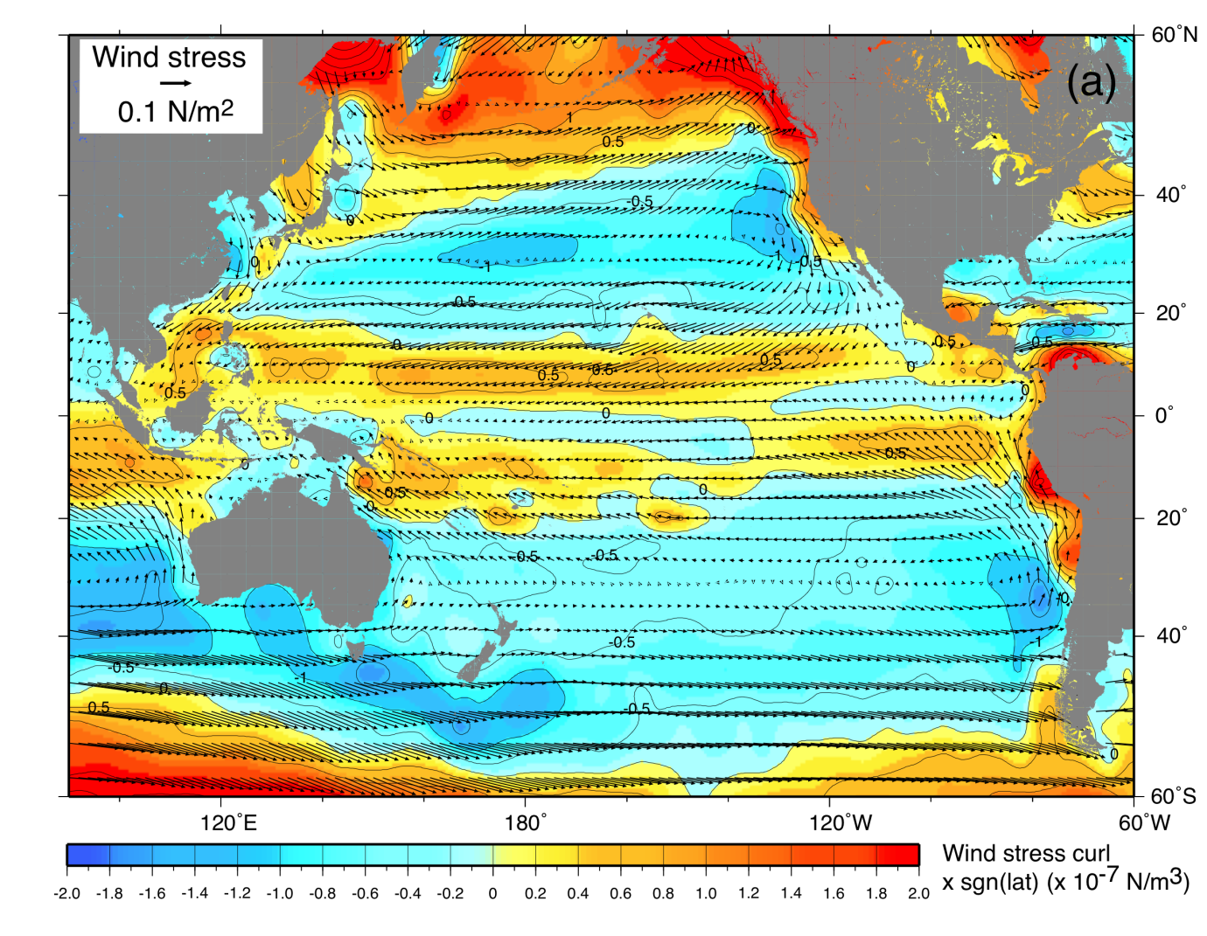
Forcing: Pacific wind stress and wind stress curl (mean)
Wind stress (vectors)
Blue: Ekman pumping (downwelling regions)
Yellow-red: Ekman suction (upwelling regions)

Slide 3
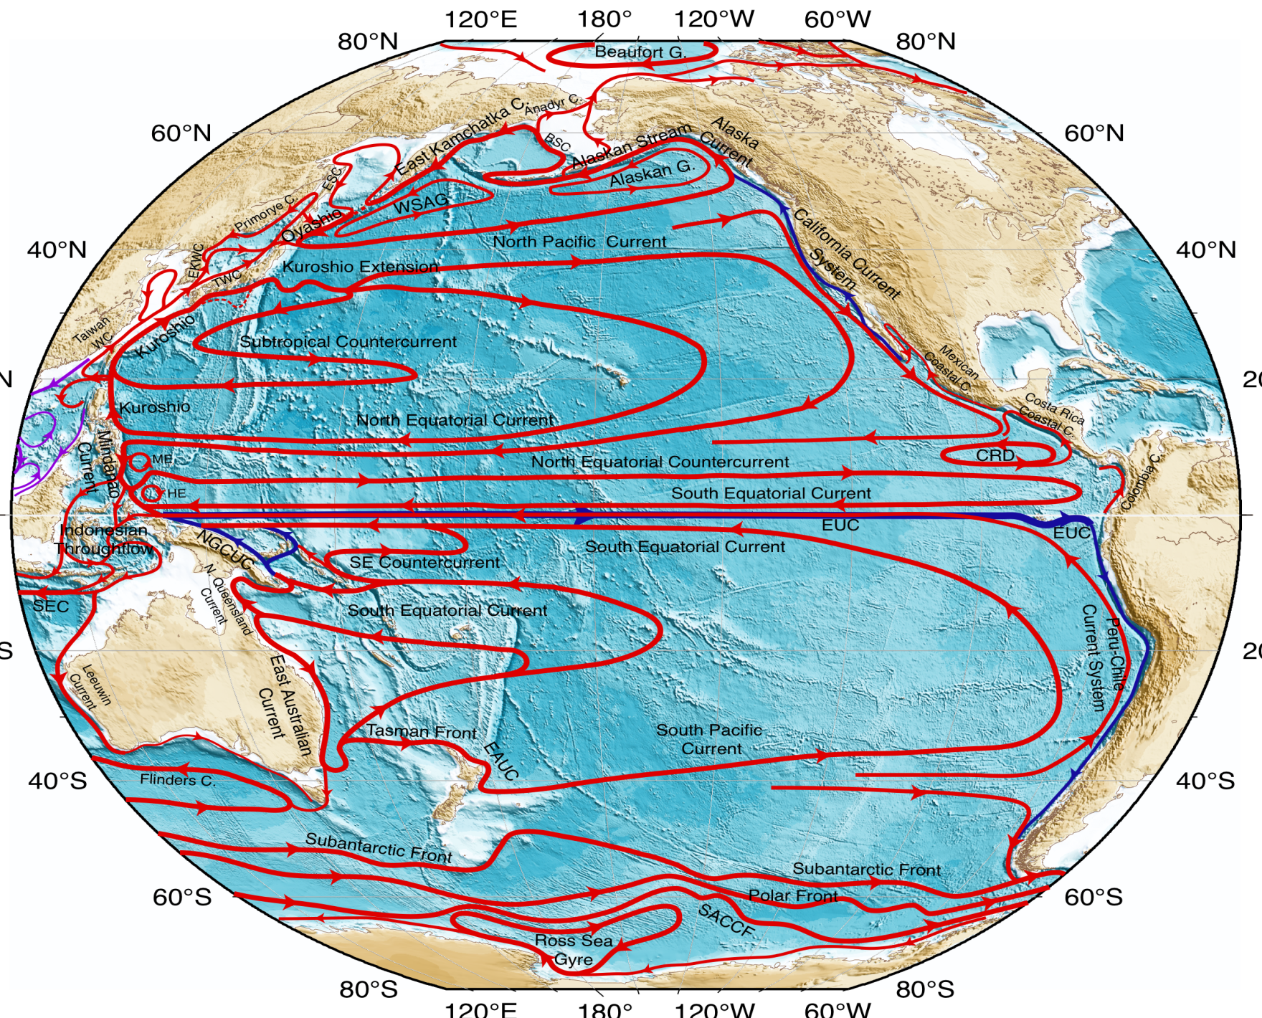
Surface circulation

Slide 4
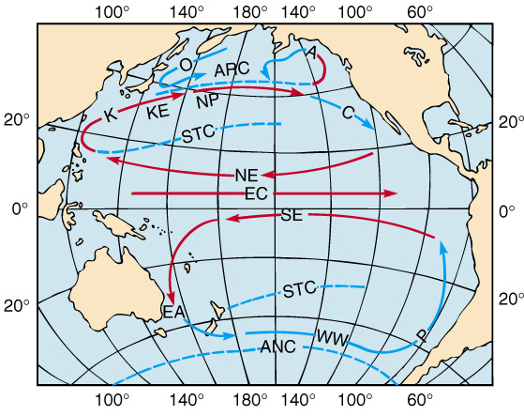
Ocean Circulation at the Equator

Slide 5

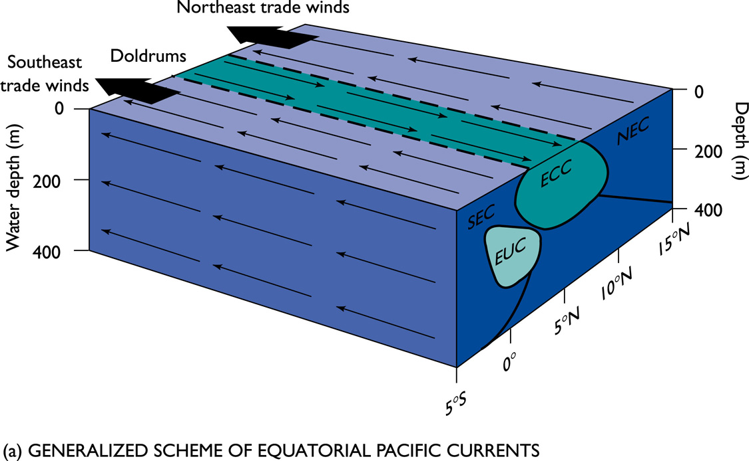
The Northern and Southern Equatorial Currents (SEC and NEC) range from ~10ºN - 20 ºN and ~0 º - 10 º S
They are shallow currents, mostly confined to the well mixed surface layer (~200m)
Velocity ranges between 0.3m/s and 1.0m/s with the SEC being stronger in flow.
Each current transports ~15 Sv

Slide 6
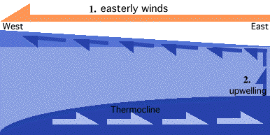
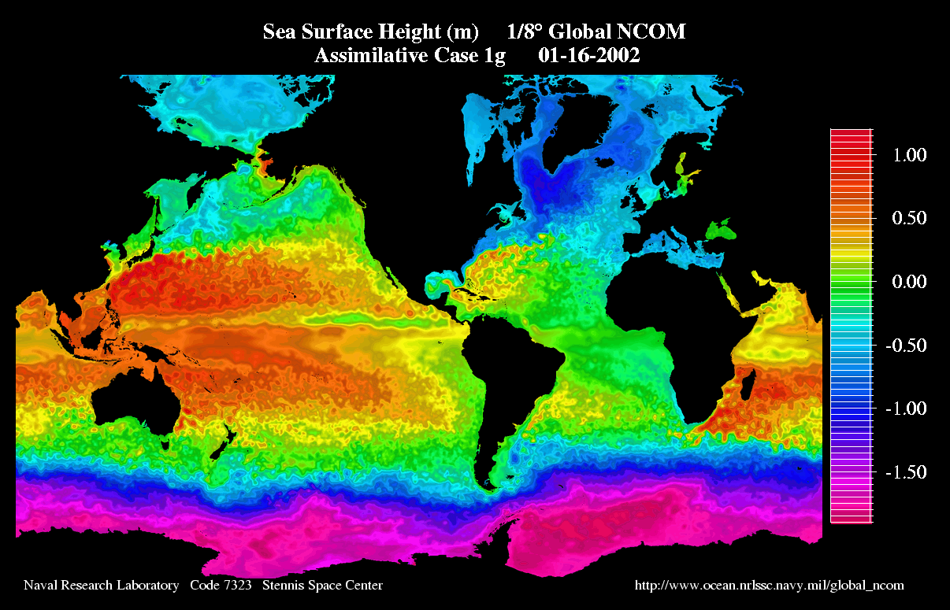
The NEC and SEC are pushed eastwards by the trade winds and pile up water in the western portion of each equatorial ocean basin
The surface ocean is ~0.5m higher in the western region of the pacific (by Indonesia) then in the eastern region (by South America) In the absence of wind and Coriolis force (f), gravity pushes the water east.

Slide 7
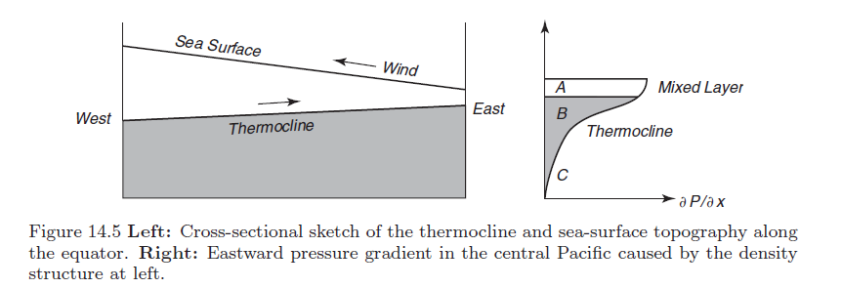
So how do you explain the mechanics of this process?
A
The eastward pressure gradient at the surface is balanced by the wind stress Tx associated with the trade winds,
Tx/H = −∂p/∂x (for layer A)
where H is the mixed-layer depth
Wind stress pushes water westwards, producing the deep thermocline and warm pool in the west. The deepening of the thermocline with distance towards Indonesia i.e. Westwards causes the sea-surface topography ζ to be higher in the west.

Slide 8
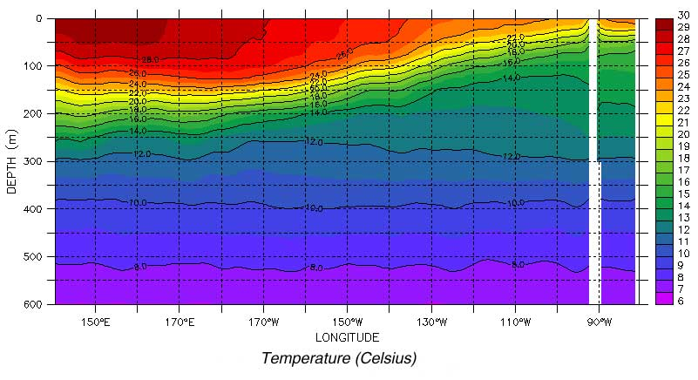
This is what it looks like from actual data!
Deep thermocline in the west and shallow in the east

Slide 9
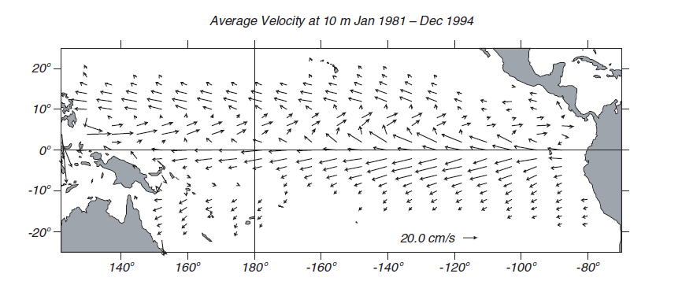

Slide 10
Between the wind driven NEC and SEC, there is the relatively narrow (300-500 km wide) eastward-flowing Equatorial Counter-Current – ECC
Speeds are in the order of 50 cm/s.

Slide 11
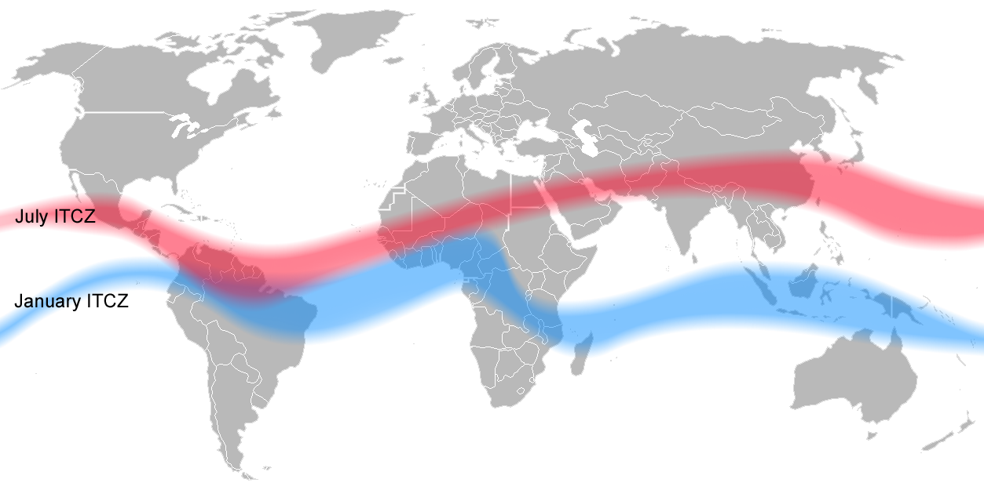
The current is centered on the band of weak winds, the doldrums, around 5–10◦N where the north and south trade winds converge, forming the ITCZ.
The position of the ECC is influenced by the migration of the ITCZ

Slide 12
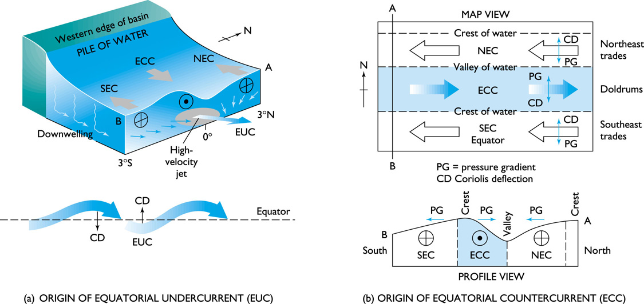
The ECC exists along the equator where winds are very weak due to the ITCZ. Thus, allowing water pushed westward by the NEC and SEC to flow back eastwards. This change in direction results in a depression in the surface

Slide 13
The Equatorial Undercurrent (EUC) is a subsurface current flowing eastwards along the equator.
A narrow, swift-flowing ribbon with a thickness of 200 m and a width of at most 400 km, it displays the largest current speeds (1.5 m s⁻¹ )of the equatorial current system.
Often known as the Cromwell Current
In the Pacific it flows at a depth of 200 m in the west, rising to a depth of 40 m in the east.

Slide 14
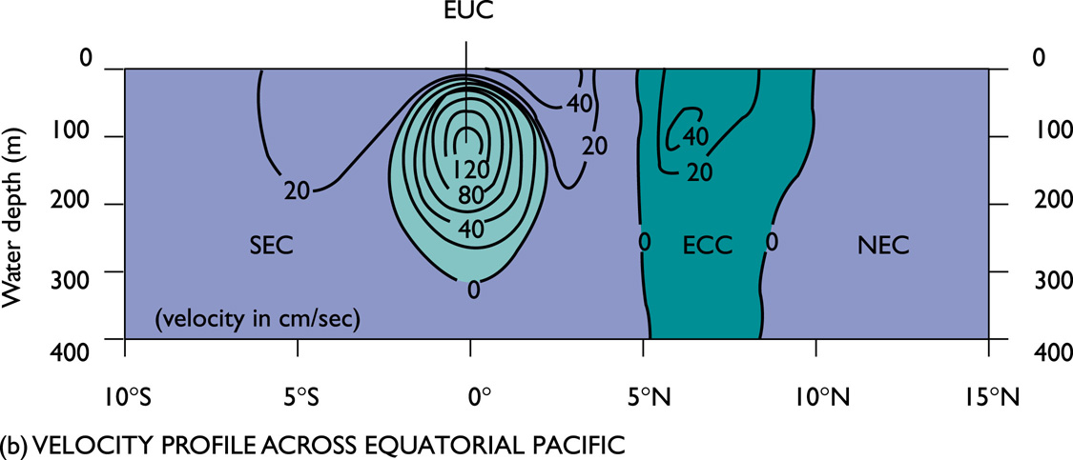
The core of the generally coincides with the thermocline and is generally centered on the equator
Gravity (due to the difference in east and western margins of the Pacific basin) is one driver of the undercurrent
The other driver is the stability provided by the Coriolis force (f)
If an easterly flow is perturbed either north or south, then the Coriolis force tends to drive the current back to the equator

Slide 15
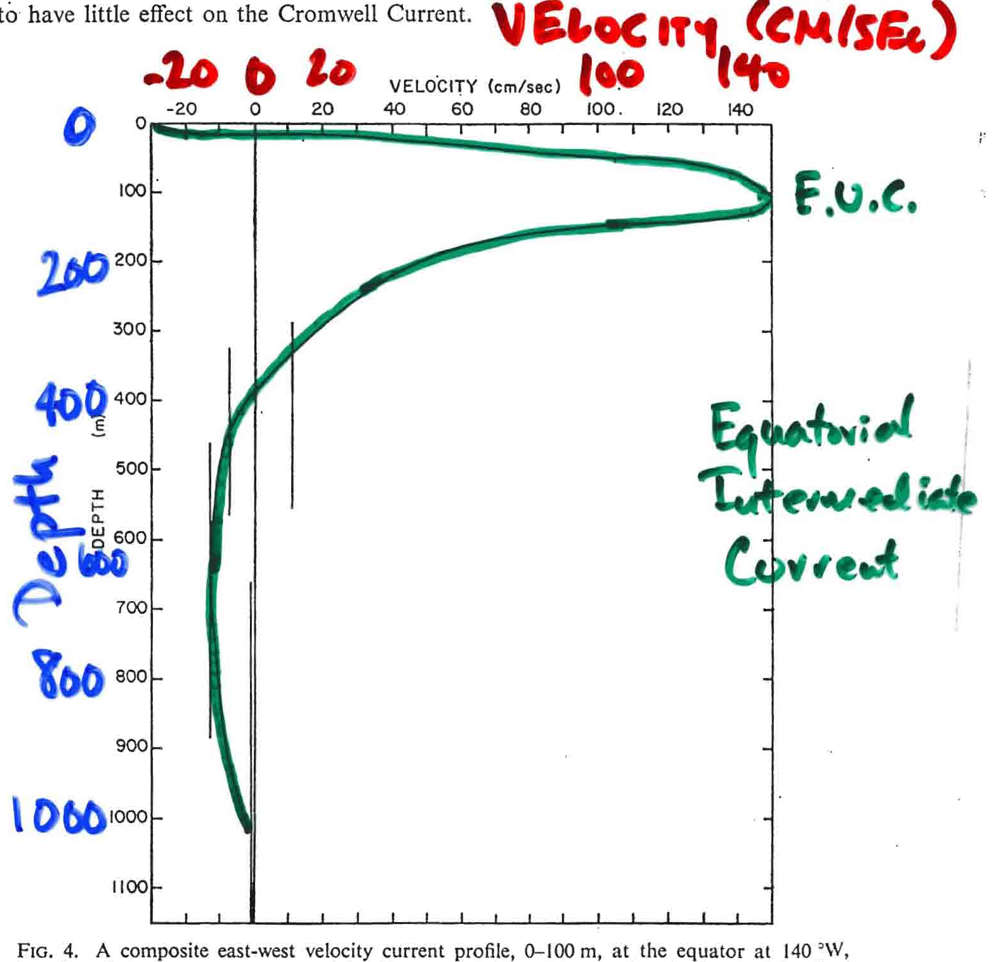

Slide 17
Just to recap - in the context of the EUC
A
B
Below A in layer B, the influence of the wind stress is small, and the pressure gradient is unbalanced, leading to an accelerated flow toward the east and thus forming the EUC.
Within this layer, the flow accelerates until the pressure gradient is balanced by frictional forces ,which tend to slow the current. At depths below the themocline (B) ~ a few hundred meters, the eastward pressure gradient is too weak to produce a current, thus
∂p/∂x ≈ 0.
Meaning the difference in pressure divided by the difference in distance east/west is zero
This explains the fast flowing subsurface EUC as well as why the EUC lies in a narrow band between 100 and 300 m.

Slide 18
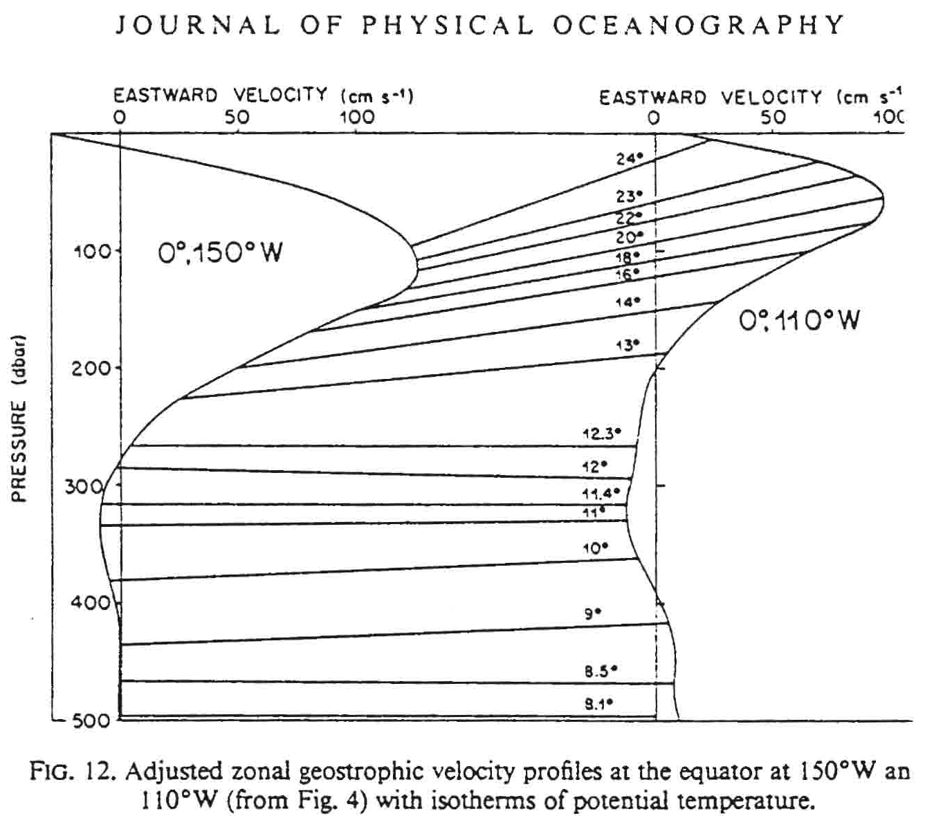
Equatorial Undercurrent: shoaling to east
Velocity profiles and isotherms at 150°W and 110°W
(Bryden and Brady, JPO, 1985)

Slide 19
IN A NUTSHELL
Equatorial Current system = 4 currents
NEC and SEC – surface currents driven by Trade winds and flow from east to west
ECC – surface current is a result of the weak winds at the ITCZ and flows from west to east
EUC – Undercurrent driven by the gravity pull from west to east as a result of the NEC and SEC piling up in the east (Indonesia)

Slide 20
IN A NUTSHELL
Equatorial Current system = 4 currents
NEC and SEC – surface currents driven by Trade winds and flow from east to west
ECC – surface current is a result of the weak winds at the ITCZ and flows from west to east
EUC – Undercurrent driven by the gravity pull from west to east as a result of the NEC and SEC piling up in the east (Indonesia)
THE ZONAL NATURE OF THE EQUATORIAL CURRENT BELT IS DUE TO THE CORIOLIS FORCE AT THIS LATITUDE
So how important is the coriolis force in this region?

Slide 21
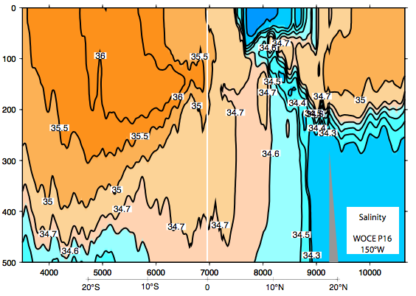
Pacific meridional salinity section crossing equator
Surface fresh band under the ITCZ
High salinity in subtropics, equatorward salinity maximum (“Subtropical Underwater”)
S. Pacific is saltier than N. Pacific
WOCE P16 (Talley, 2007)
Notes:
1. southward interior flow (North Pacific Current is the eastward portion and the North Equatorial Current is the westward portion)
2. northward western boundary current: Kuroshio

Slide 22
The velocity of a point on the Earth is a function of latitude F=2 Ω sin(ø)
The Coriolis deflection is therefore related to the motion of the object, the earth’s rotation and the latitude.
Closer to the equator the Coriolis parameter becomes very small, going to zero at the equator....see for yourself....
Ω = rotation of earth = 2π/86400 sec⁻¹
ø = latitude

Slide 23
F=2 Ω sin(ø)
Calculate the coriolis parameter (F=2 Ω sin(ø)) for the following regions:
1˚N, 40˚N, 55˚N, 89˚N
Ω (earth’s rotation rate) = 2π/86400 sec⁻¹

Slide 24
1.45 x 10⁻⁴ x sin latitude1 = 0.0254 10⁻⁴ s⁻¹
1.45 x 10⁻⁴ x sin latitude40 = 0.935 x10⁻⁴ s⁻¹
1.45 x 10⁻⁴ x sin latitude55 = 1.19 x10⁻⁴ s⁻¹
1.45 x 10⁻⁴ x sin latitude89 = 1.45 x10⁻⁴ s⁻¹
Why the difference???... Its because of the earths shape!

Slide 25
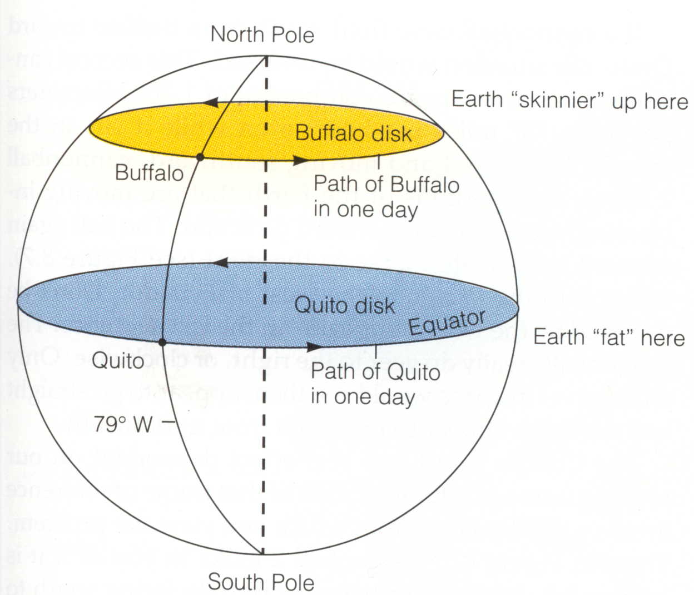

Slide 26
Circumference of the Earth at the Equator = 40,000 kilometers
Time to complete one Rotation = 24 hours
Speed of Rotation = Distance/Time = 40,000 km / 24 hr = 1670 km/hr
Circumference of the Earth at 40°N = 30,600 kilometers
Time to complete one Rotation = 24 hours
Speed of Rotation at 40° North = Distance/Time = 30,600 km / 24 hr = 1280 km/hr

Slide 27
Circumference of the Earth at the Equator = 40,000 kilometers
Time to complete one Rotation = 24 hours
Speed of Rotation = Distance/Time = 40,000 km / 24 hr = 1670 km/hr
Circumference of the Earth at 40°N = 30,600 kilometers
Time to complete one Rotation = 24 hours
Speed of Rotation at 40° North = Distance/Time = 30,600 km / 24 hr = 1280 km/hr

Slide 28
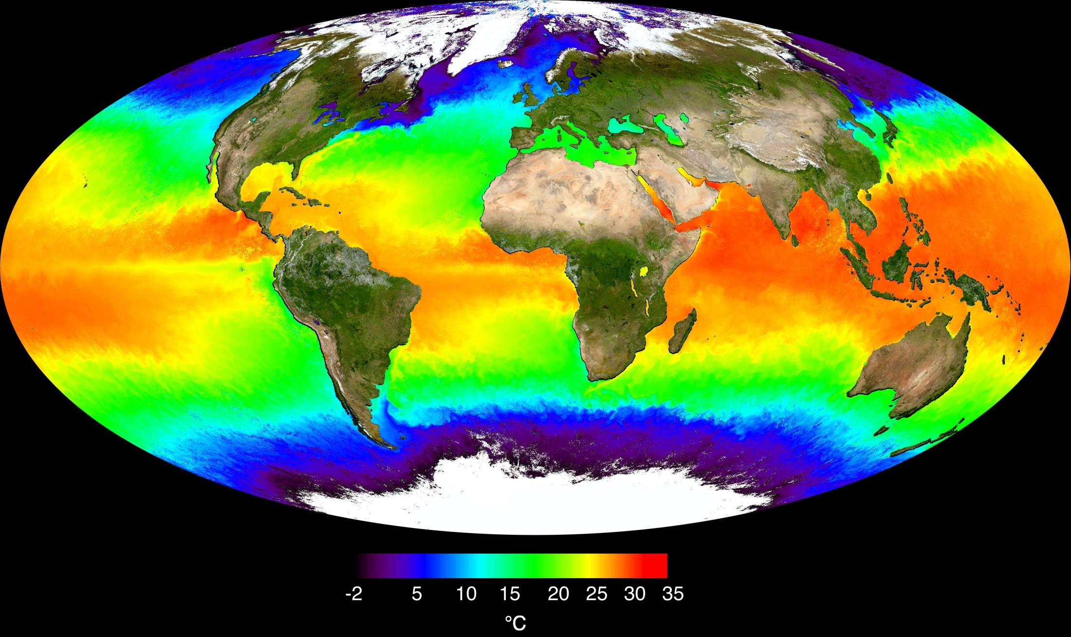
When you look at the Equator the water is surprisingly cold! – why?

